Slide 1
Design aspects of Li-ion battery for electric vehicles
Under the Supervision of
Dr. B. Pattabhi Ramaiah
Submitted by
Prateek Gandhi
MTech, Mechanical Systems Design
IIT Bhubaneswar
20-09-2021

Slide 2
Objectives
To estimate the influence of cathode materials on the power output characteristics of Lithium-ion batteries.
Study the performance of the battery, considering the real-time operating conditions like temperature, humidity, to name a few.
To estimate overall power losses with time associated with the battery pack under operating conditions.
Devise the methods to reduce the power losses and enhance the battery life, e.g.: battery thermal management systems.
20-09-2021
Notes:
In the presence of high capacity electrodes, Lithiation and delithiation are one of the main factors responsible for the short life span of Lithium-based batteries. The SOC dependent mechanical properties of cathode materials as well as crack simulation will be estimated through molecular dynamics simulations using Large-scale Atomic/Molecular Massively Parallel Simulator (LAMMPS).

Slide 3




Li-ion batteries have enabled major innovations in energy
Automotive^{[1]}
Renewable grid^{[2]}
Drones^{[3]}
Mobiles^{[4]}
[1] https://www.citroen.in/
[2] https://www.massnetcomms.org/software-to-simplify-solar-farm-design/
[3] https://www.ga-asi.com/remotely-piloted-aircraft/mq-9a
[4] https://www.apple.com/in/
20-09-2021

Slide 4
...but today’s Li-ion batteries still face many challenges
Safety
Energy Density
Cost
Cycle Life
20-09-2021

Slide 5
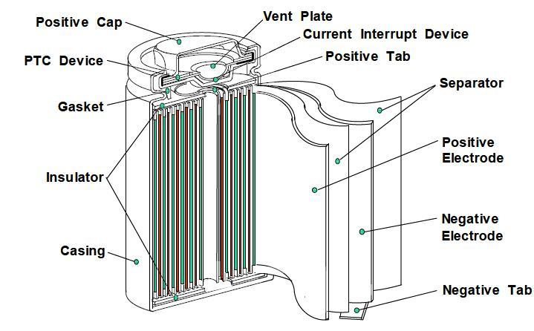
Working of a battery
The cell is made up of a number of different layers; copper foil which acts as the current collector for the anode, a porous anode which is normally made up of graphite.
A porous cathode which is made up of a transition metal oxide and an aluminium foil which acts as the cathode current collector.
Finally, a liquid electrolyte which allows for the movement of lithium ions. (Lithium Salt in an Organic Solvent)
Figure: Cross-sectional view of a conventional battery cell^{[5]}
[5] https://batteryuniversity.com/article/bu-301a-types-of-battery-cells
20-09-2021

Slide 6
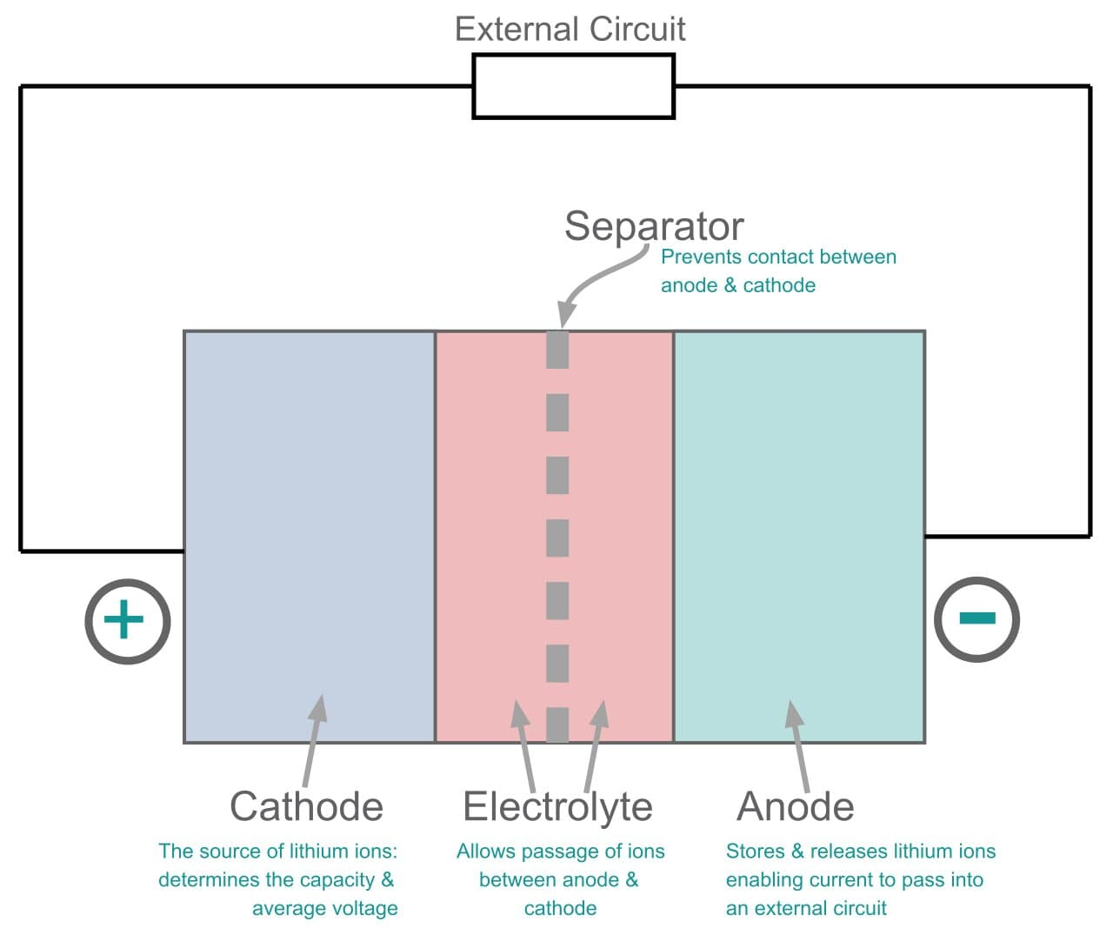
Working of a battery
When the battery is fully charged, lithium exists in between the carbon layers of the graphite. When the battery is discharged, the lithium becomes a lithium ion and an electron the lithium ions can travel through the electrolyte towards the cathode however the electrons have to go around an external circuit where useful electrical work can be extracted.
At the cathode the lithium ions and electrons recombine and go into the layers of the transition metal oxide in a process called intercalation.
When charging the battery the opposite reaction occurs, moving the lithium back into the anode.
This back and forth motion coins the term “rocking chair mechanism” which represents how a lithium-ion battery works.
Figure: A schematic of a conventional battery^{[6]}
[6] https://www.electronics-notes.com/articles/electronic_components/battery-technology/li-ion-lithium-ion-technology.php
20-09-2021

Slide 7
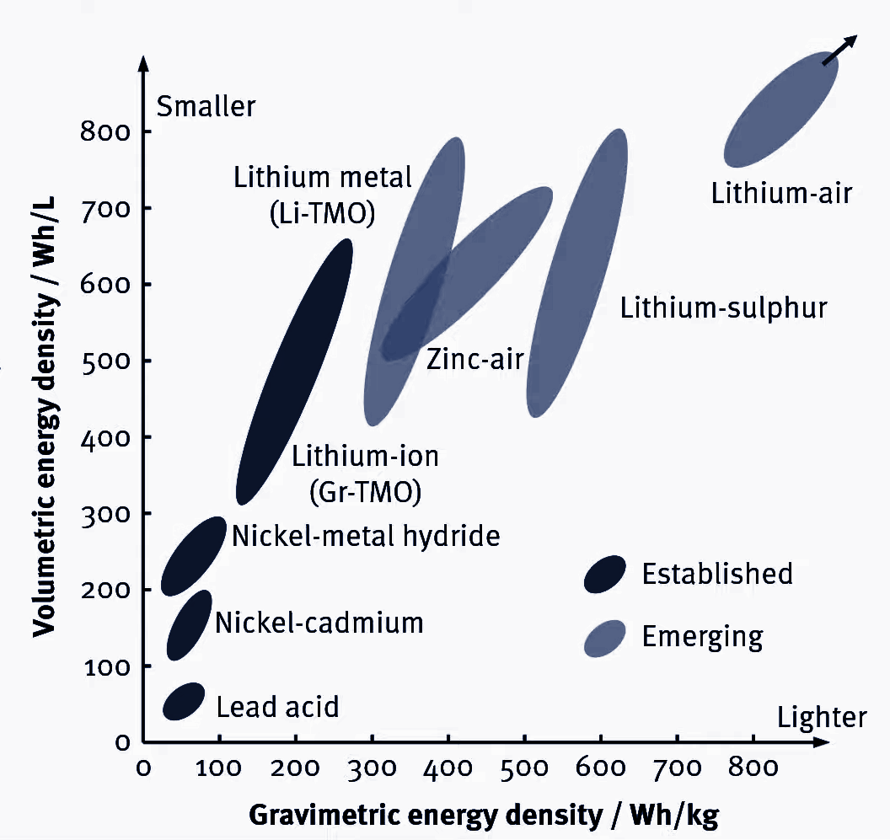
Battery Technologies
Figure: Energy Density vs Specific Energy of different technologies^{[7]}
[7] Salgado, Rui Martim, Federico Danzi, Joana Espain Oliveira, Anter El-Azab, Pedro Ponces Camanho, and Maria Helena Braga. "The Latest Trends in Electric Vehicles Batteries." Molecules 26, no. 11 (2021): 3188.
20-09-2021

Slide 8
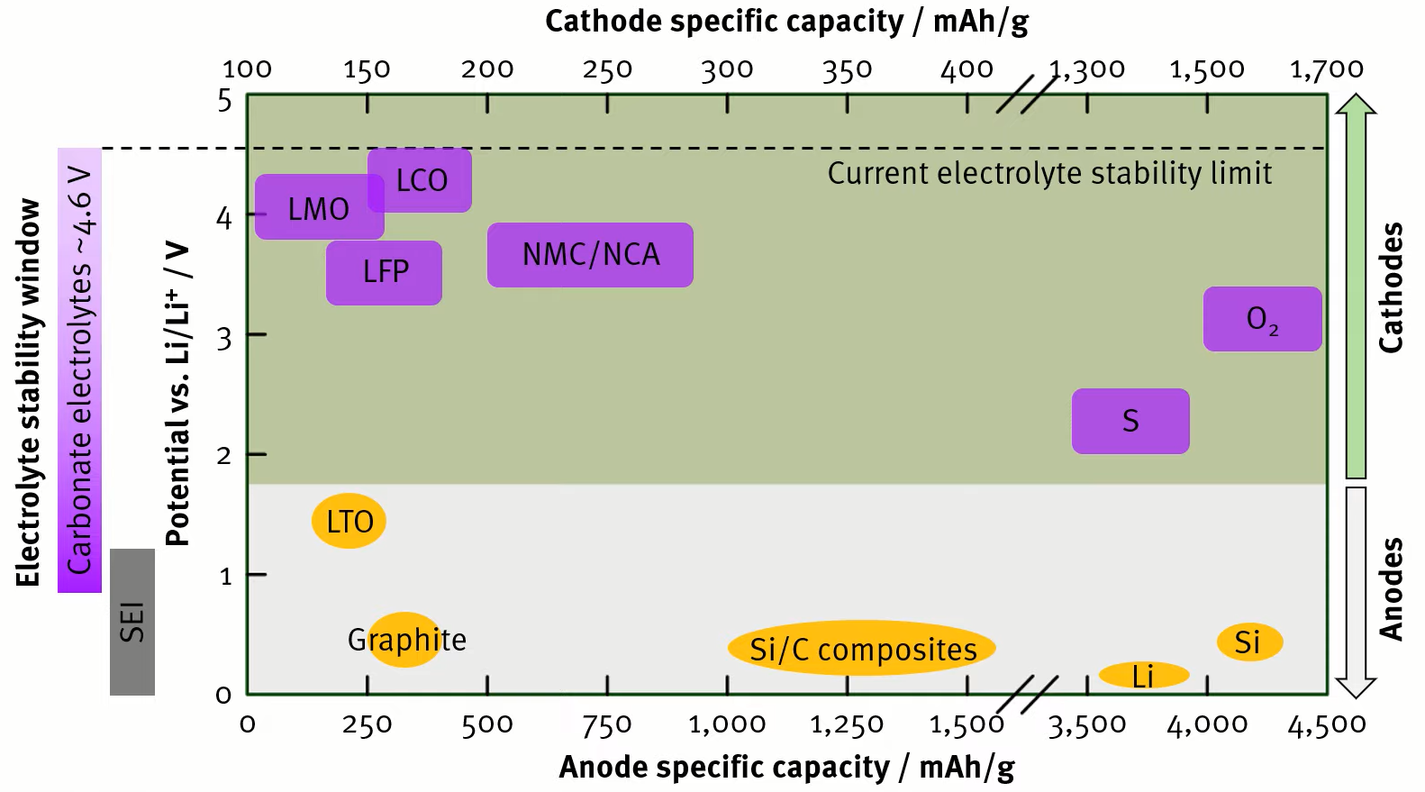
Battery Chemistry
Figure: Comparison of different cathode and anode materials^{[7]}
[8] Mohamed, Nourhan, and Nageh K. Allam. "Recent advances in the design of cathode materials for Li-ion batteries." RSC Advances 10, no. 37 (2020): 21662-21685.
20-09-2021

Slide 9
Challenges and trend in cathode materials for Li-ion batteries
The development of the cathode materials for Li-ion batteries remains challenging because the existing materials such as layered transition metals oxides, olivines, or spinel all show upsides and downsides.[8]
Analysis of their performance is done of different cathode materials that have been widely used in Li-ion batteries.
[8] Mohamed, Nourhan, and Nageh K. Allam. "Recent advances in the design of cathode materials for Li-ion batteries." RSC Advances 10, no. 37 (2020): 21662-21685.
20-09-2021

Slide 10
Table: Comparison of different cathode materials
Battery | Energy Density (Wh/kg) | Cyclability (Cycles) | Advantages | Disadvantages
LCO | 150–190 | 500–1000 | Technological maturity, Low-self discharge, High discharge voltage | High cost, low inherent safety
LMO | 100–140 | 1000–1500 | High inherent safety, Cobalt-free | Low energy density
LFP | 90–140 | up to 2000 | High inherent safety | Low energy density
NCA | 200–250 | 1000–1500 | Low cobalt content | Capacity fade at elevated temperature
NMC | 140–200 | 1000–2000 | Low cobalt content | Safety issues in Ni-rich batteries
20-09-2021

Slide 11
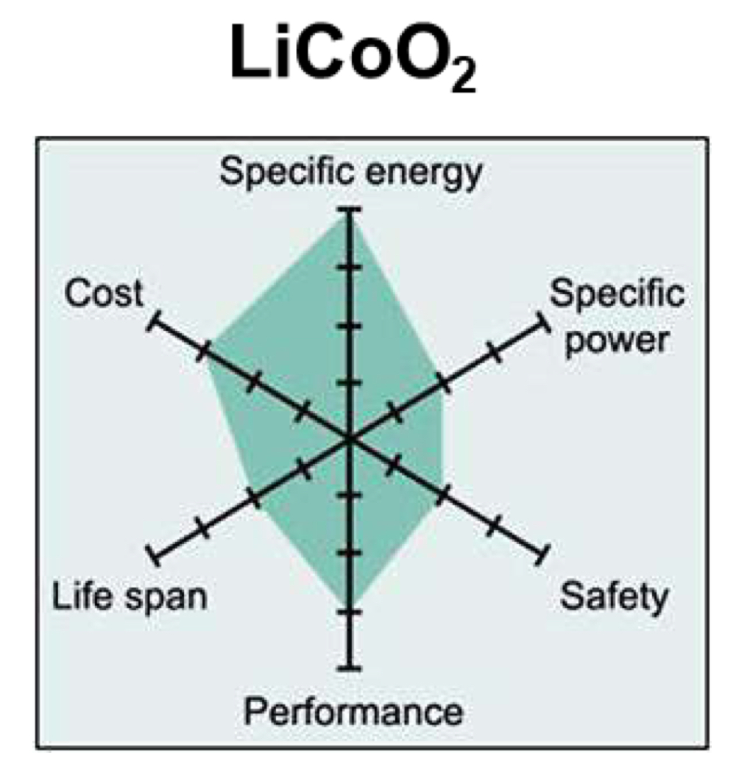
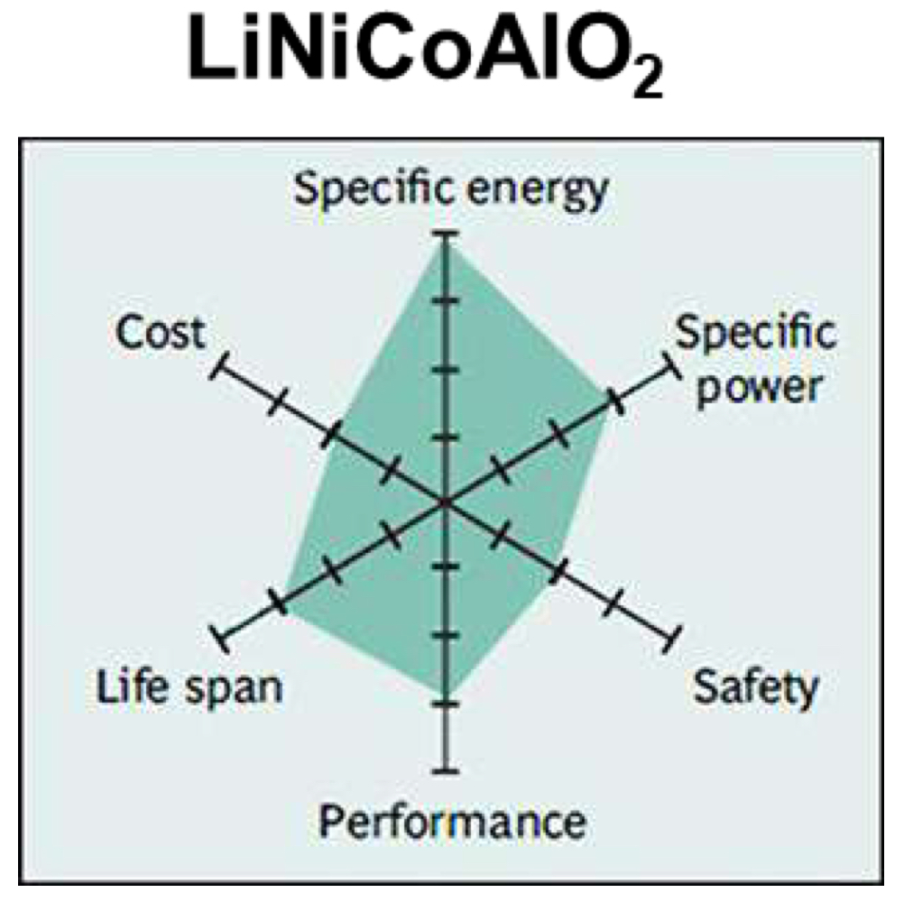
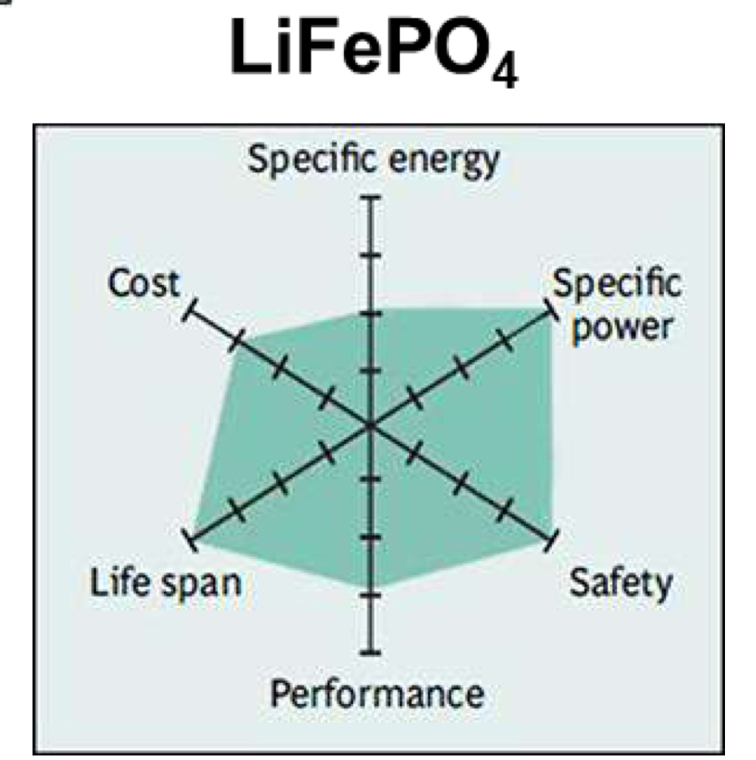
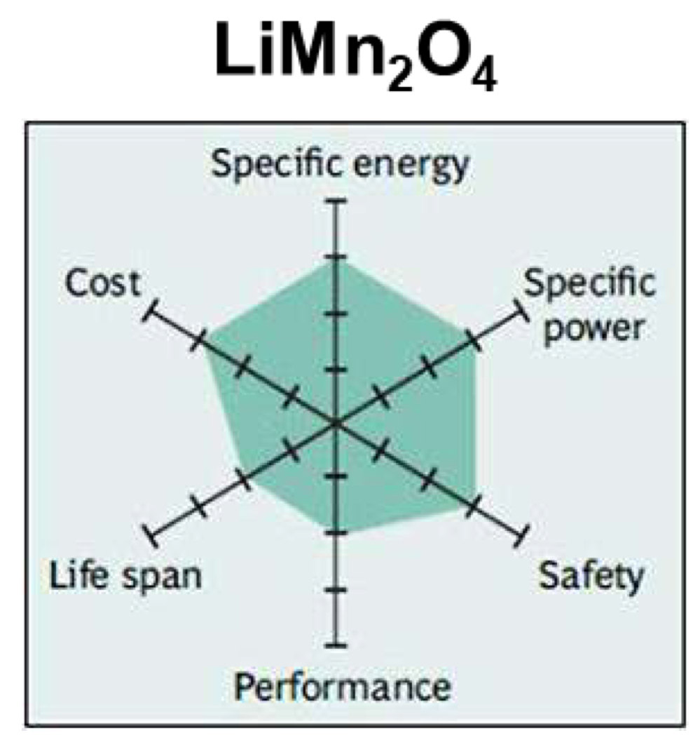
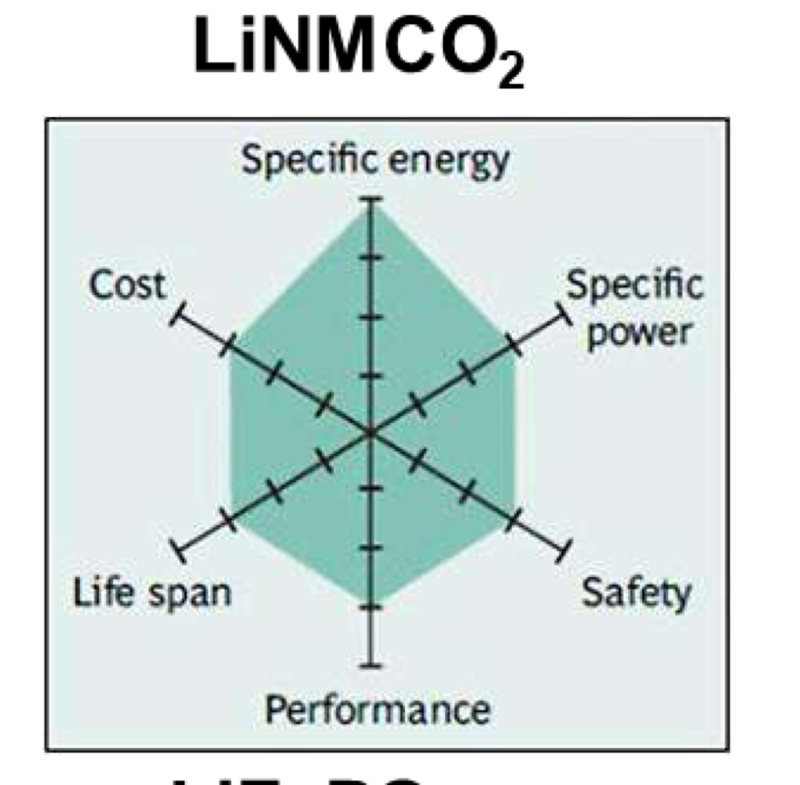
Comparison of different cathode materials
Figure: Comparison of different cathode materials; LMO, LFP and NMC stand out as being superior among these candidates.
20-09-2021
Not to scale

Slide 12
Molecular dynamics modeling of Li_{x}Mn₂O₄
Spinel LiMn₂O₄ is one of the most attractive energy storage materials due to its low cost and reversible and fast intercalation and deintercalation of Li ions.[8]
The LiMn₂O₄ spinel structure (space-group: Fd3m), consists of oxygen ions close-packed array occupy the 32e position, Mn ions occupy the octahedral site 16d, and Li+ occupies the tetrahedral 8a site.
[8] Mohamed, Nourhan, and Nageh K. Allam. "Recent advances in the design of cathode materials for Li-ion batteries." RSC Advances 10, no. 37 (2020): 21662-21685.
20-09-2021

Slide 13
Molecular dynamics modeling of Li_{x}Mn₂O₄
All ions of LMO unit cell are in a cubical structure in the Fd3m space group. [8]
Using the data, the unit cell of LMO was made using VESTA (short for Visualisation for Electronic Structural Analysis). A 3D visualization programme for structural models, volumetric data such as electron/nuclear densities, and crystal morphologies.
Space Group: F d -3 m
a = 8.24500 Å α = 90.0000°
b = 8.24500 Å β = 90.0000°
c = 8.24500 Å γ = 90.0000°
V = 560.4953 Å³
[8] Mohamed, Nourhan, and Nageh K. Allam. "Recent advances in the design of cathode materials for Li-ion batteries." RSC Advances 10, no. 37 (2020): 21662-21685.
20-09-2021

Slide 14
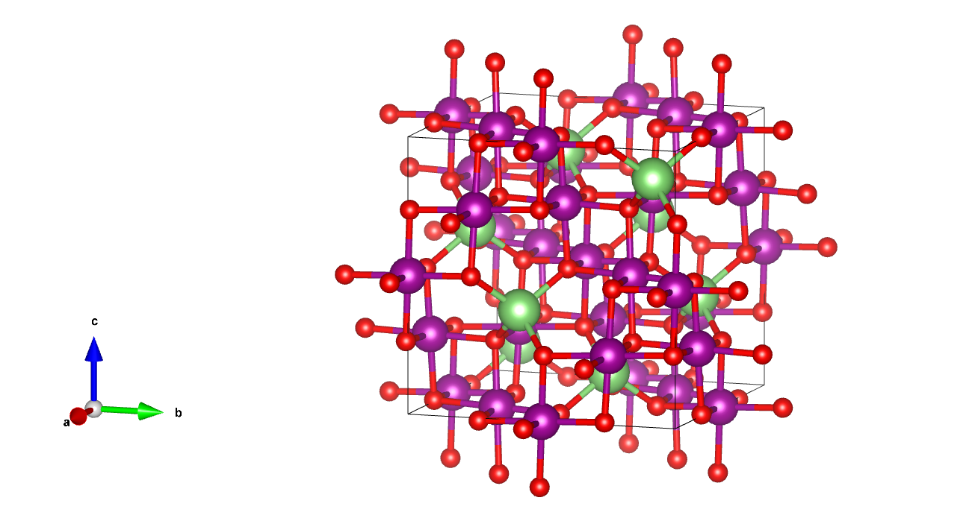
Unit cell of LMO
Figure: A unit cell of LMO made using “VESTA”
20-09-2021

Slide 15
Next steps: To calculate SOC dependent mechanical properties of LMO using LAMMPS
The mechanical properties of Li_{x}Mn₂O₄ are generally composed of three terms: the kinetic energy contribution, the long-range coulombic interactions and the pair interactions.
The kinetic energy contribution and long-range coulombic interactions do not change during the electrochemical charge cycle. In fact, the only responsible phenomenon for the mechanical properties’ changes during electrochemical cycling is pair-interactions.
Potential file for Li-Mn-O system capturing all the interatomic and intra-atomic interactions.
During electrochemical cycling (Li-ion insertion and extraction), the amounts of these ions change and consequently the pair-interactions also change. These variations determine the pattern of the mechanical properties’ changes.[9]
20-09-2021
[9] Asadi, Ali, Seyed Foad Aghamiri, and Mohammad Reza Talaie. "Molecular dynamics simulation of a Li x Mn 2 O 4 spinel cathode material in Li-ion batteries." RSC Advances 6, no. 116 (2016): 115354-115363.

Slide 16
Next steps: To calculate SOC dependent mechanical properties of LMO using LAMMPS
To investigate the SOC-dependent mechanical properties of LiMn2O4, a series of room temperature uniaxial deformation MD simulations at 6(say) different SOC values (i.e., x = 1(fully discharged), 0.625, 0.5, 0.375, 0.25, and 0(fully charged)) and various strain rates needs to be performed.
Strain rates correspond to different operational C-rates in Li-ion batteries. [9]
To evaluate the stress–strain relationship we use an atomic-level stress tensor in the form of the virial stress. That is expressed as follows:
20-09-2021
[9] Asadi, Ali, Seyed Foad Aghamiri, and Mohammad Reza Talaie. "Molecular dynamics simulation of a Li x Mn 2 O 4 spinel cathode material in Li-ion batteries." RSC Advances 6, no. 116 (2016): 115354-115363.

Slide 17
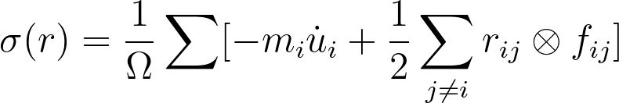
Next steps: To calculate SOC dependent mechanical properties of LMO using LAMMPS
where i and j are the atomic indices, Ω is the total volume, m_{i} is the mass of atom i, is the displacement vector of atom i relative to a reference position, r_{ij} = r_{i} − r_{j}, and f_{ij} is the interatomic force applied on atom i by atom j.
20-09-2021
[9] Asadi, Ali, Seyed Foad Aghamiri, and Mohammad Reza Talaie. "Molecular dynamics simulation of a Li x Mn 2 O 4 spinel cathode material in Li-ion batteries." RSC Advances 6, no. 116 (2016): 115354-115363.

Slide 18
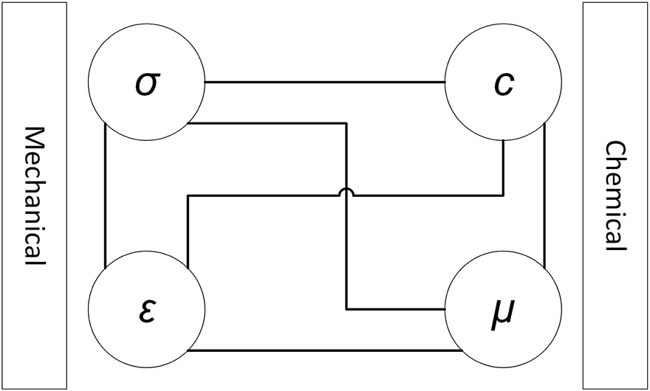
Strain rate relation to C-rate
Because of the chemo-mechanical nature of a Li-ion battery, there are interconnections between the mechanical and chemical aspects of any intercalation material such as LiMn₂O₄ that are shown in the figure.
The Vegard relation and Lithium composition profile, are used to determine the applied strain rates.
Figure: The interconnections between mechanical and chemical aspects of any intercalation material. ^{[9]}
20-09-2021
[9] Asadi, Ali, Seyed Foad Aghamiri, and Mohammad Reza Talaie. "Molecular dynamics simulation of a Li x Mn 2 O 4 spinel cathode material in Li-ion batteries." RSC Advances 6, no. 116 (2016): 115354-115363.

Slide 19

Strain rate relation to C-rate
ε_{c} represents the compositional strain and β_{ij} are the Vegard coefficients. 𝚫 X is the change in the lithium concentration.
Because of the cubic structure of LiMn₂O₄, it has isotropic Vegard coefficients.
Therefore all Vegard coefficients are considered the same and equal to 0.016 based on Chung et al.’s report. [15]
Example: For three different strain rates (0.001 ps⁻¹, 0.01 ps⁻¹, and 0.1 ps⁻¹), corresponding C-rates are 0.5 C, 5 C, and 50 C, respectively. [9]
[9] Asadi, Ali, Seyed Foad Aghamiri, and Mohammad Reza Talaie. "Molecular dynamics simulation of a Li x Mn 2 O 4 spinel cathode material in Li-ion batteries." RSC Advances 6, no. 116 (2016): 115354-115363.
20-09-2021
[15] Chung, Ding-Wen, Paul R. Shearing, Nigel P. Brandon, Stephen J. Harris, and R. Edwin Garcia. "Particle size polydispersity in Li-ion batteries." Journal of The Electrochemical Society 161, no. 3 (2014): A422.

Slide 20
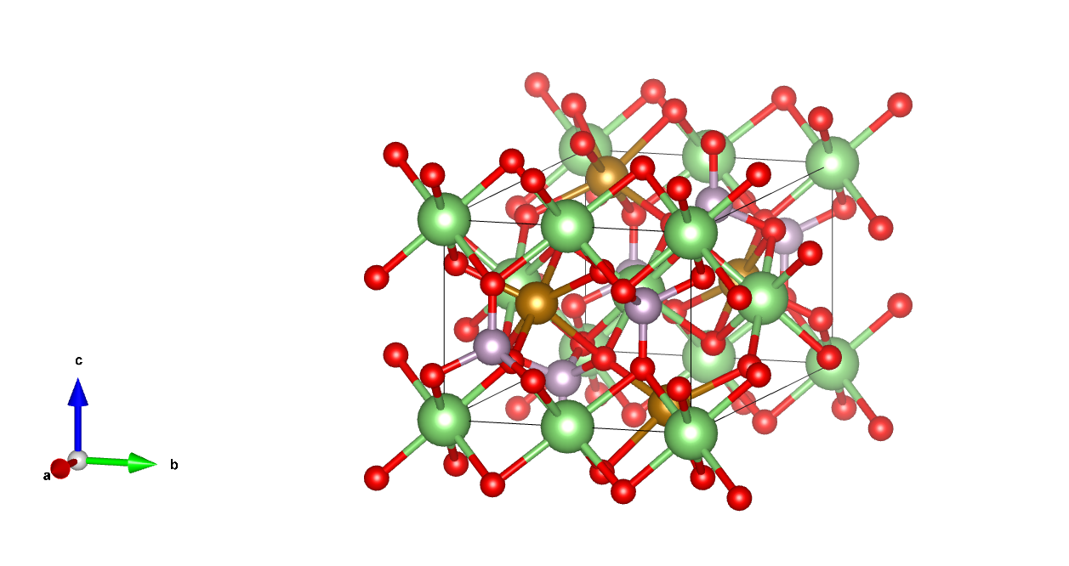
Unit cell of LFP
Space Group: P n m a
a = 10.40080 Å α = 90.0000°
b = 6.05230 Å β = 90.0000°
c = 4.73240 Å γ = 90.0000°
V = 297.8987 Å³
Figure: A unit cell of LFP made using “VESTA”

Slide 21
References
[1] https://www.citroen.in/
[2] https://www.massnetcomms.org/software-to-simplify-solar-farm-design/
[3] https://www.ga-asi.com/remotely-piloted-aircraft/mq-9a
[4] https://www.apple.com/in/
[5] https://batteryuniversity.com/article/bu-301a-types-of-battery-cells
[6] https://www.electronics-notes.com/articles/electronic_components/battery-technology/li-ion-lithium-ion-technology.php
20-09-2021

Slide 22
References
[7] Salgado, Rui Martim, Federico Danzi, Joana Espain Oliveira, Anter El-Azab, Pedro Ponces Camanho, and Maria Helena Braga. "The Latest Trends in Electric Vehicles Batteries." Molecules 26, no. 11 (2021): 3188.
[8] Mohamed, Nourhan, and Nageh K. Allam. "Recent advances in the design of cathode materials for Li-ion batteries." RSC Advances 10, no. 37 (2020): 21662-21685.
[9] Asadi, Ali, Seyed Foad Aghamiri, and Mohammad Reza Talaie. "Molecular dynamics simulation of a Li x Mn 2 O 4 spinel cathode material in Li-ion batteries." RSC Advances 6, no. 116 (2016): 115354-115363.
[10] Warner, John T. The handbook of lithium-ion battery pack design: chemistry, components, types and terminology. Elsevier, 2015.
[11] Masias, Alvaro, James Marcicki, and William A. Paxton. "Opportunities and challenges of lithium ion batteries in automotive applications." ACS Energy Letters 6, no. 2 (2021): 621-630.
20-09-2021

Slide 23
References
[12] Miao, Yu, Patrick Hynan, Annette Von Jouanne, and Alexandre Yokochi. "Current Li-ion battery technologies in electric vehicles and opportunities for advancements." Energies 12, no. 6 (2019): 1074.
[13] Bandhauer, Todd M., Srinivas Garimella, and Thomas F. Fuller. "A critical review of thermal issues in lithium-ion batteries." Journal of the Electrochemical Society 158, no. 3 (2011): R1.
[14] Wu, Xiangkun, Kaifang Song, Xiaoyan Zhang, Naifang Hu, Liyuan Li, Wenjie Li, Lan Zhang, and Haitao Zhang. "Safety issues in lithium ion batteries: Materials and cell design." Frontiers in Energy Research 7 (2019): 65.
20-09-2021

Slide 24
Thank you.

